Slide 1
Airbnb Price Prediction
Group No.1
Aaryan Sharma
Deependra Rajauriya
Kapil Sisodia
Siddharth Singh
Ashish kr. Yadav
Harsh Dhaka
Vishal Singh
Rajeev Choudhary
Mentor
Mr. Srikar Muppidi

Slide 2
Problem Definition
Aim is to predict daily prices for the properties.
The need of solving this problem is to maximize company’s profit and keep the customers happy at the same time.
It will help businesses make aware of the factors which are actually contributing or affecting the prices of the properties. With this information they can work on or rectify there pain points and eventually optimize the grab over the market.
This estimation of prices will lead to have a proactive glance or assessment of revenue for the coming next quarter or an year which again would make business decisive and optimized.

Slide 3
Suggested Solution and EDA
Applied Different ML regression models to get better results.
Finally landed to Random Forest Regressor
Dataset - Airbnb Listings
Exploratory data analytics done
There were many challenges which we faced during the EDA which includes Outliers, missing values and unwanted values as well.

Slide 4
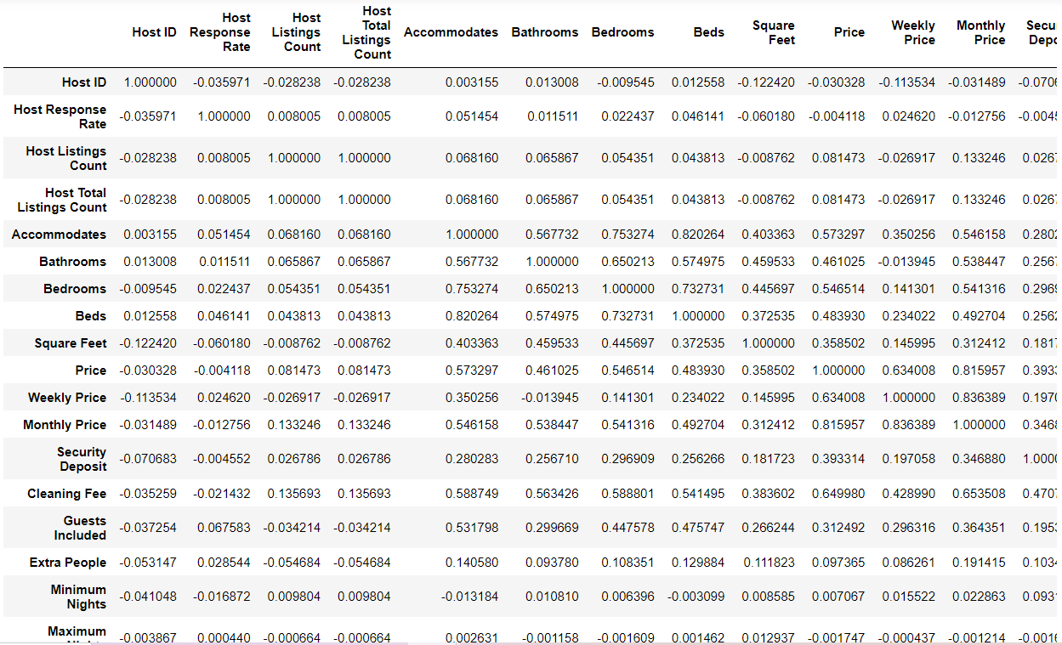

Slide 5
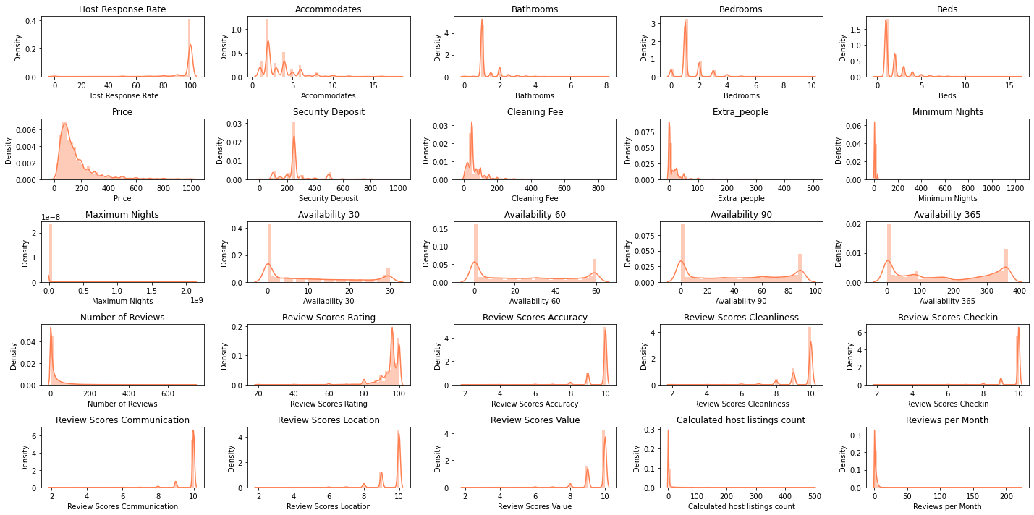
Univariate Analysis

Slide 6
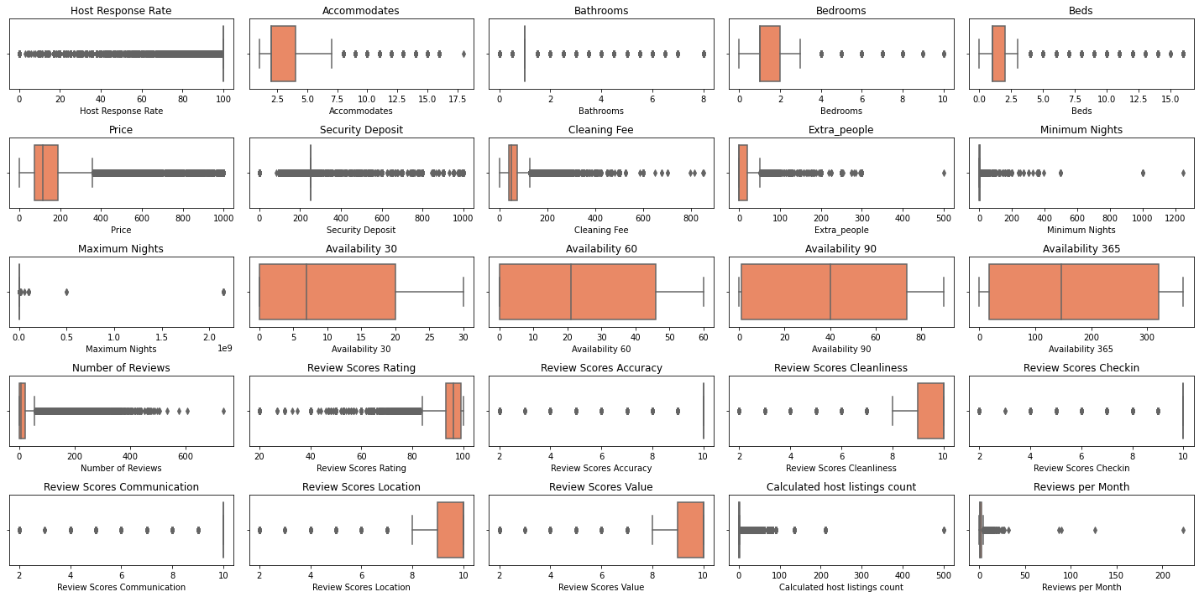
Box Plot

Slide 7
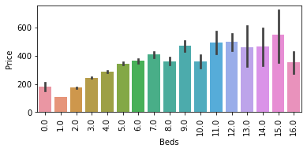
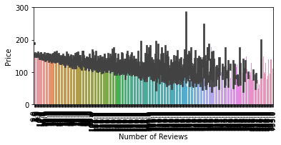
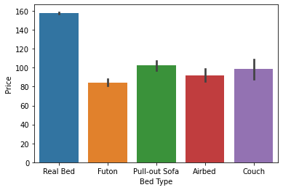
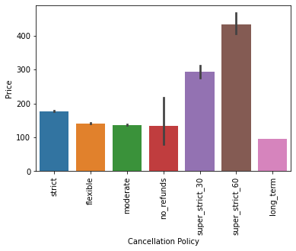
Bar Charts

Slide 8
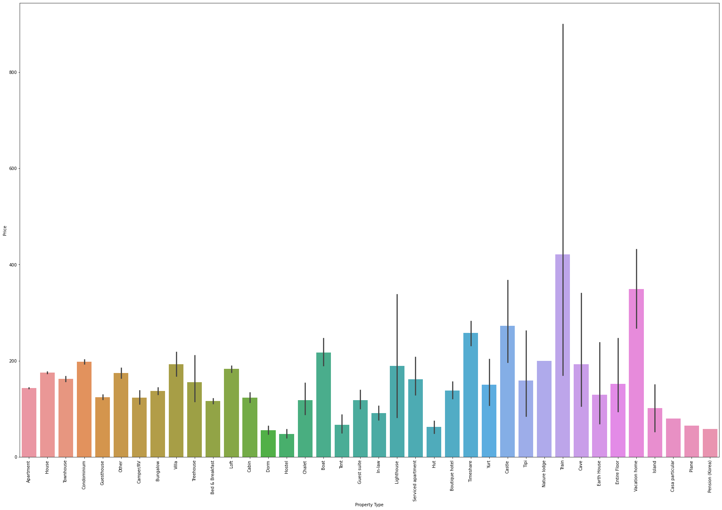
Property Type vs Price

Slide 9
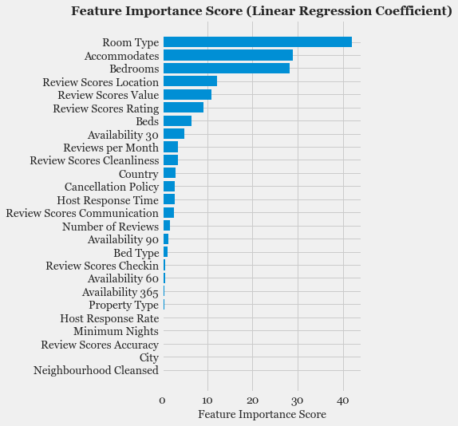
Feature Selection

Slide 10
Algorithms, Solution and Conclusions
OLS Model – Significant R2 and Adj. R2 values It suggested with 7 insignificant features
Regression - Bettered OLS model with R2 value but larger RMSE, MAE as well.
Decision Tree – Turned out to be the worst one with highest RMSE (0.77)
Random Forest Regressor – Best fit model with better R2 and reduced RMSE, MAE scores.
RMSE – 0.42, R2 – 72.98, Adj. R2 – 70.70
MAE – 0.27
To sum up, Random Forest Regressor turned out to be the best fit model for this problem as it reduced the RMSE to 0.52 and MAE – 0.27

Slide 11
Model Evaluation
Model | R2 | Adj. R2 | RMSE/MAE
OLS | 0.607 | 0.607 | -
Linear Regression | 0.604 | 0.604 | 0.627/0.47
Decision Tree | 0.391 | 0.391 | 0.777
Random Forest Regressor | 0.715 | 0.705 | 0.526/0.388
We tries PCA but it worsened the model with shotted RMSE as 0.98
XG Boost also didn’t work

Slide 12
Thanks!

